Slide 1

Guidelines
Kindly use the given template for submitting your project (Make a copy of the template)
One team is only required to submit one project/ppt.
The ideal size of the presentation should not be more than 10 slides.
You are welcome to add as many POCs and design concepts to support your project.
The project should be feasible and the team members should be capable enough, to come up with the prototype of the same idea, if required.
Solutions must include at least one Google technology.

Slide 2
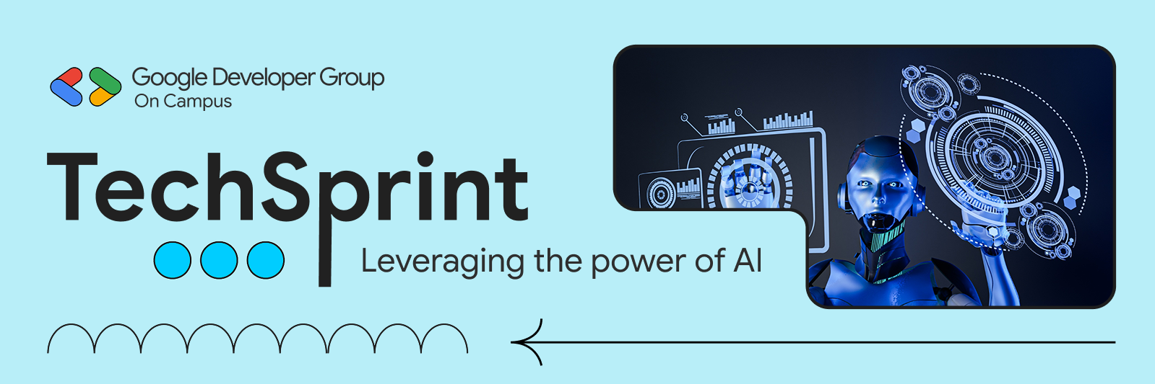
Team Details
Team name: Quantum Minds
Team leader name: Apurva Deshpande
Problem Statement: Open Innovation

Slide 3
Problem Statement
Despite advancements in technology, women’s personal safety remains a critical challenge in real-world scenarios. Women often find themselves in unsafe situations where every second is crucial, yet existing safety mechanisms fail when they are needed the most.
Immediate help is difficult to access
Fear and panic hinder rational decision-making
Internet connectivity is unreliable or unavailable
Using a visible safety application can escalate the threat
Our Solution – HerShield
HerShield is a real-time women safety mobile application that acts as an AI-powered emergency companion, providing instant assistance, offline emergency alerts, and stealth protection during critical situations.
One-tap SOS with live location sharing
AI-powered safety assistant that listens and analyzes
Multi-channel emergency alerts (SMS + WhatsApp)
Stealth emergency mode (calculator disguise

Slide 4
Opportunities
a. How is HerShield different from existing ideas?
Existing safety apps are reactive and internet-dependent.
HerShield is AI-powered, proactive, and offline-capable.
Designed specifically for panic and real-world emergencies.
Provides discreet protection to avoid threat escalation.
Uses multi-channel alerts to ensure reliability.
b. How will HerShield solve the problem?
Reduces response time during emergencies
Ensures alert delivery even without internet connectivity
Supports users under panic with minimal actions
Provides reliable, real-time safety assistance

Slide 5
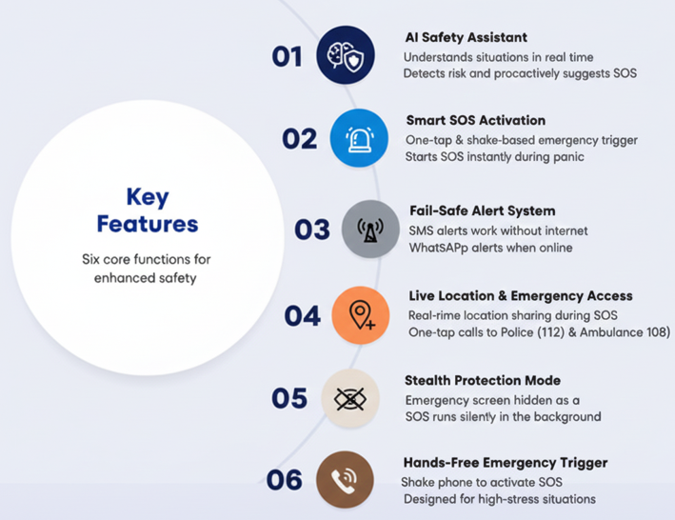
Features offered by HerShield

Slide 6
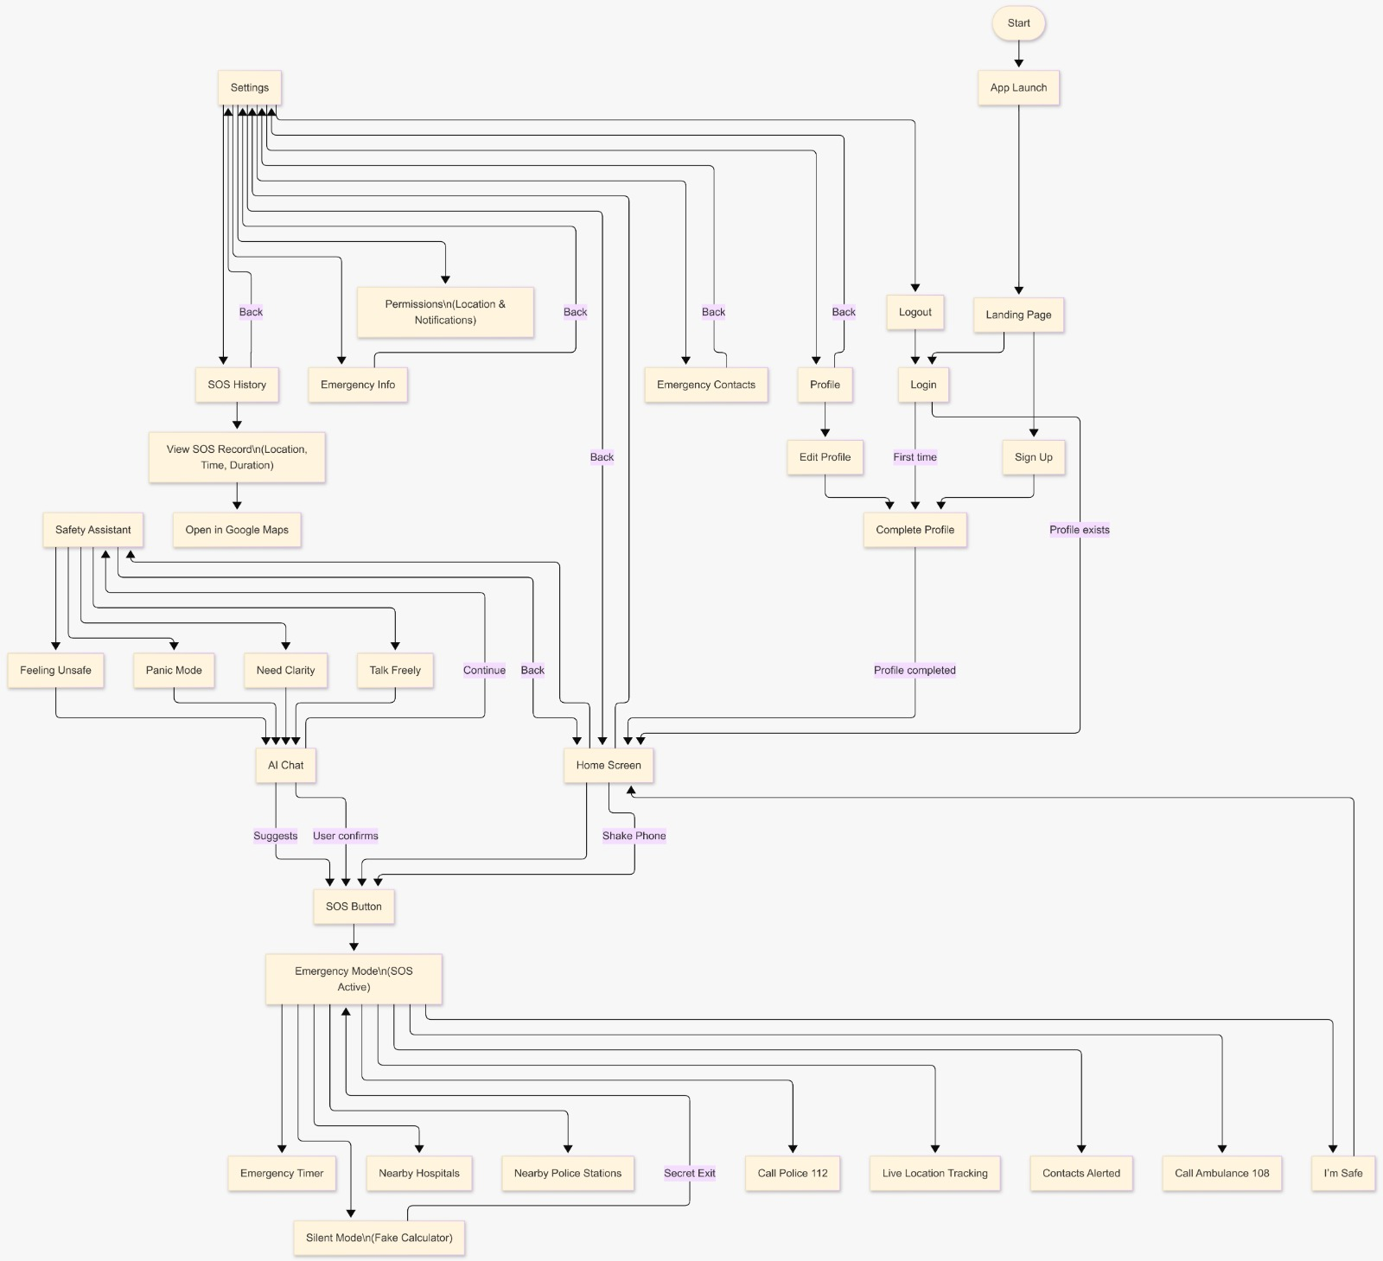
Use-case diagram

Slide 7
Google Technologies Used in HerShield
Firebase – Provides secure user authentication, real-time database updates, and cloud storage for SOS history, contacts, and profile data. Enables offline-first functionality and ensures reliable emergency alerts.
Google Cloud Platform (GCP) – Hosts backend APIs and manages cloud services. Ensures scalable, secure, and fast API access, even under heavy usage. Handles API restrictions and access control for safety-critical services.
Google Maps API – Enables live location tracking, displaying nearby police stations and hospitals, and mapping routes for emergency responses. Integrates seamlessly with SOS and AI features.
Google Gemini API – Powers the AI Safety Assistant, providing real-time analysis of user messages, risk detection, and context-aware emergency recommendations.
Google AI Studio – Used to build and deploy AI models for personalized safety suggestions, threat detection, and emergency decision support, with secure API management via Google Cloud.

Slide 8
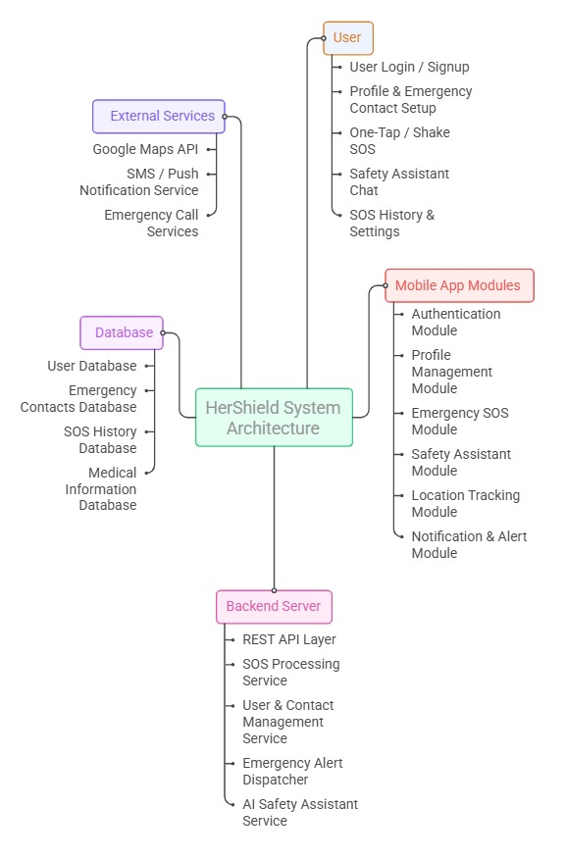
Architecture diagram of the proposed solution

Slide 9
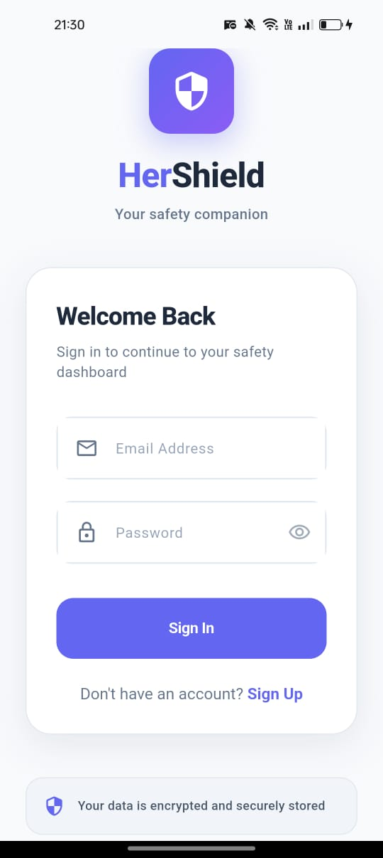
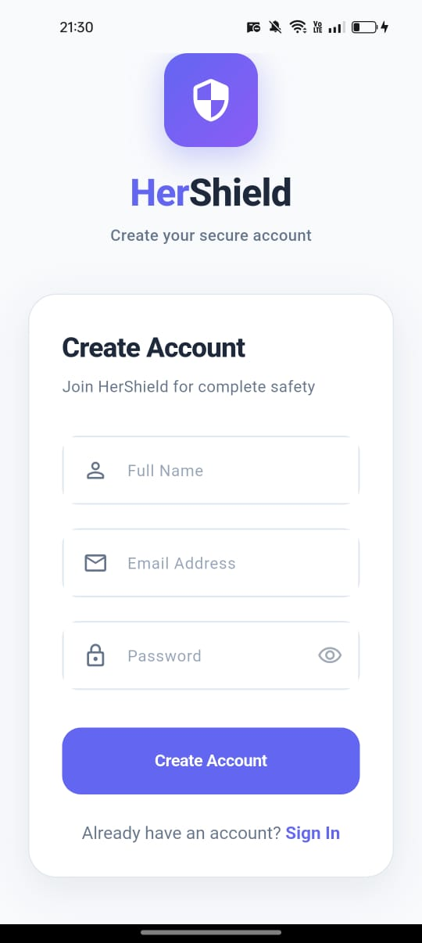
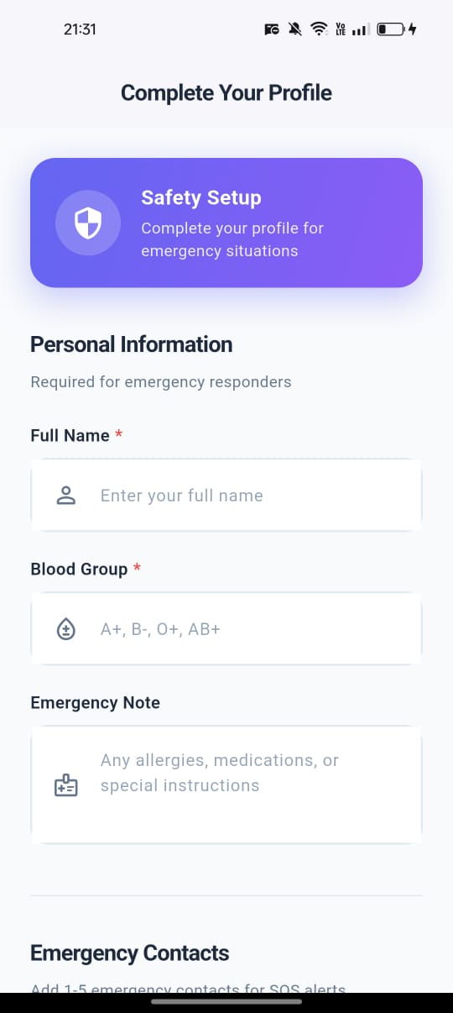
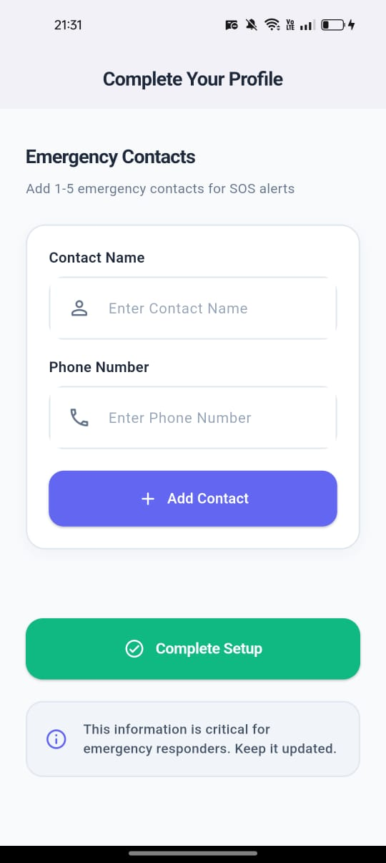
Snapshots of the MVP
Login screen Create account Profile setup screen

Slide 10
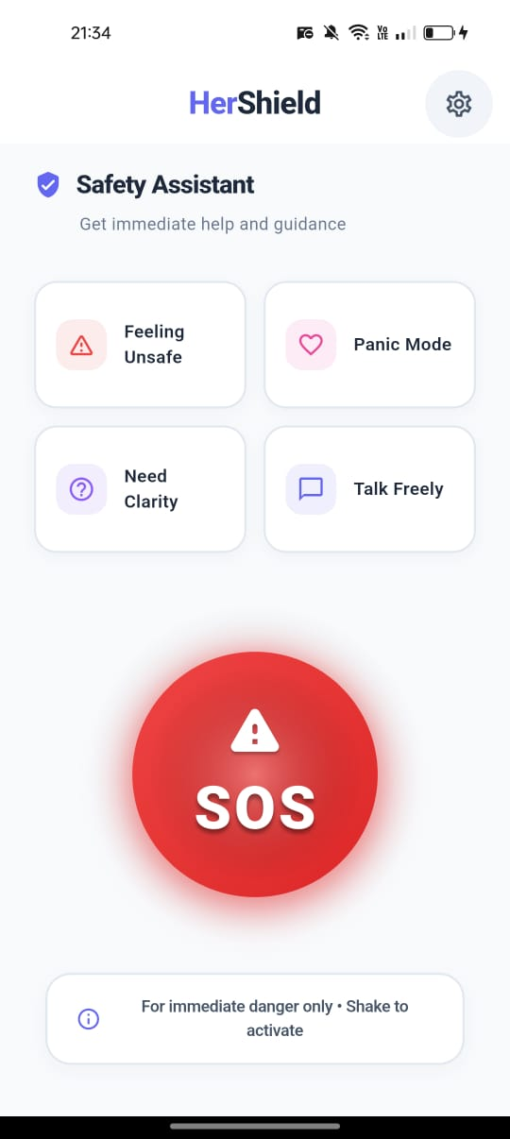
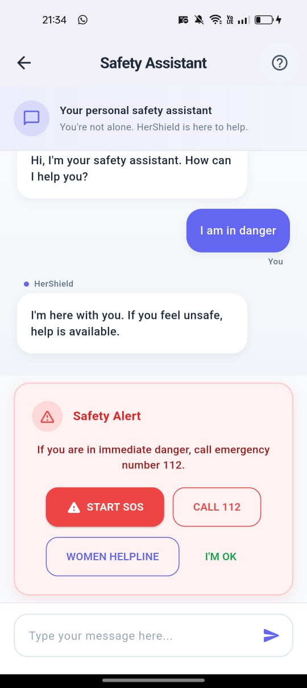
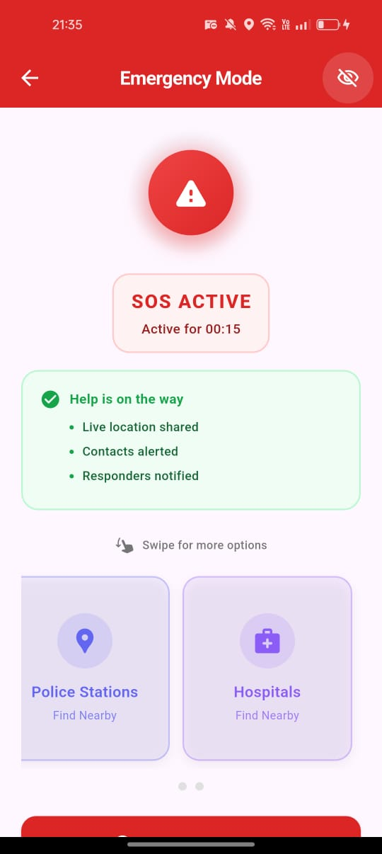
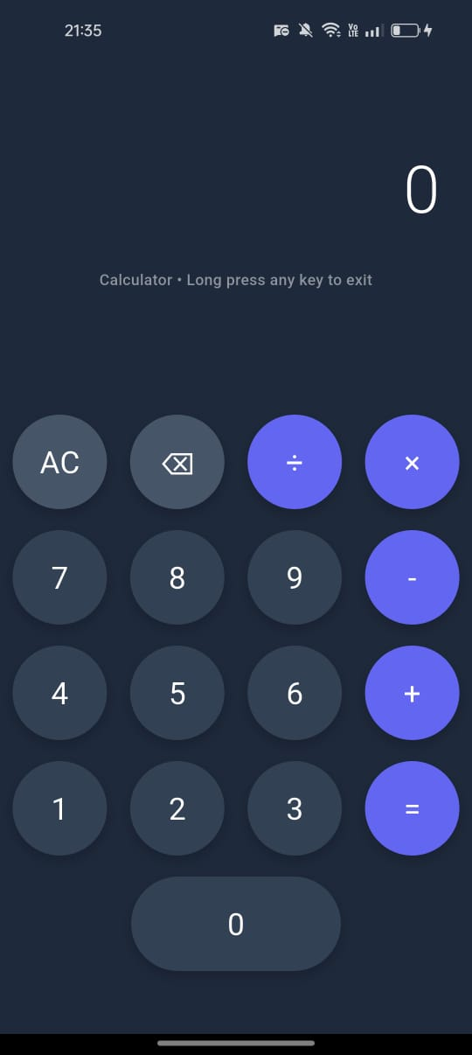
Snapshots of the MVP
Home screen
Safety assistant chat
Emergency mode screen
Calculator feature to
hide emergency screen

Slide 11
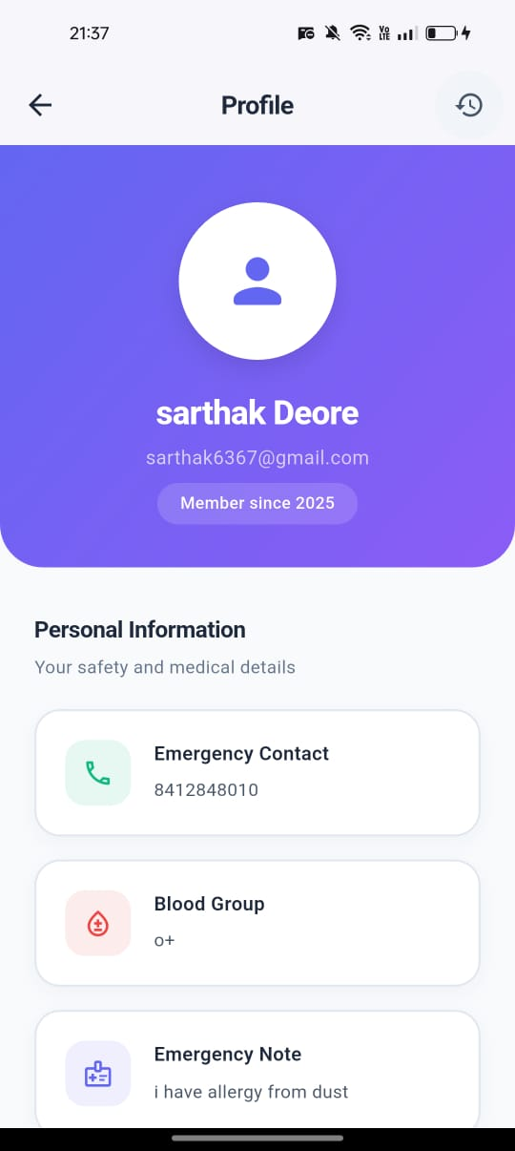
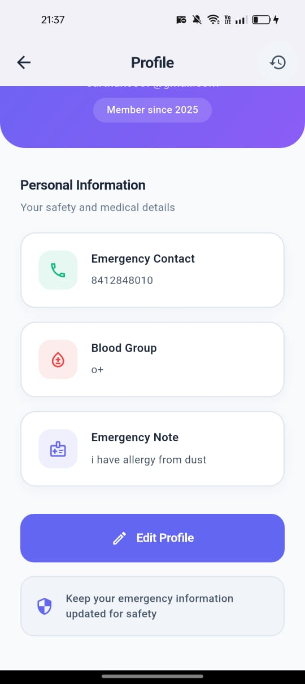
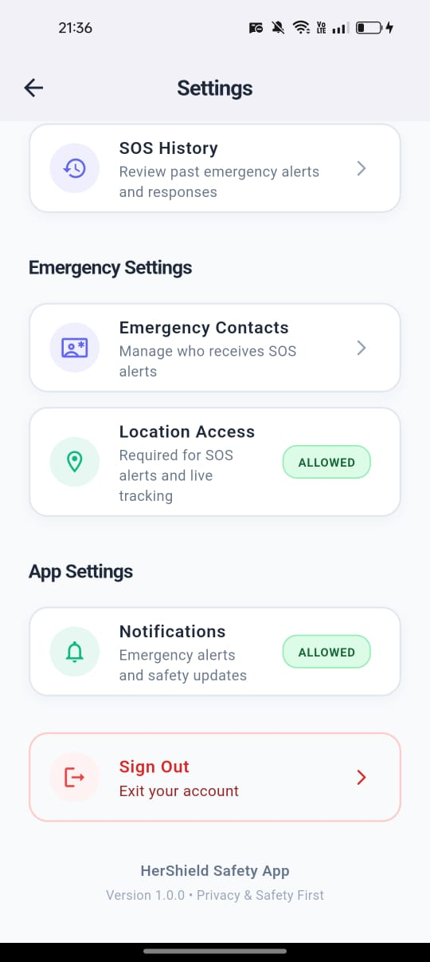
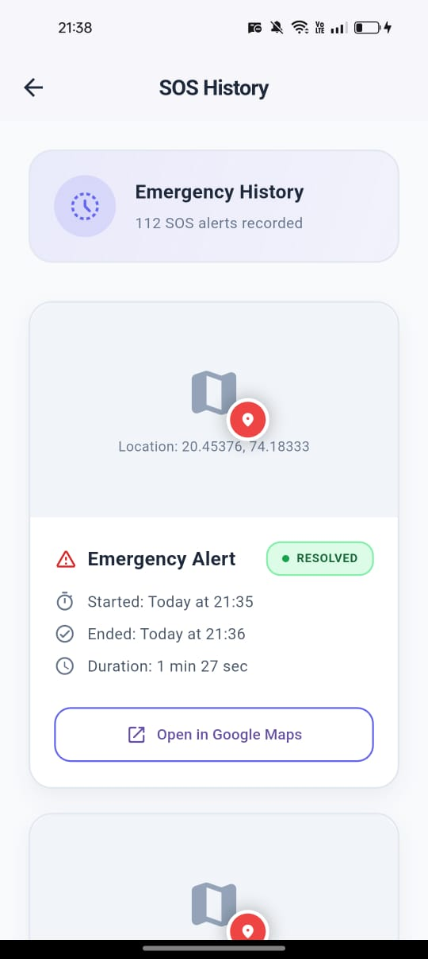
Snapshots of the MVP
Profile
Setting screen
SOS history screen

Slide 12
Additional Details/Future Development
Predictive Threat Analysis using AI & crime data
Blockchain-secured incident logs for legal evidence
Mesh network SOS using Bluetooth / Wi-Fi Direct
Satellite SOS integration for remote areas
IoT safety protocols with smart homes & vehicles
Law enforcement dashboard for real-time monitoring

Slide 13
Provide links to your:
GitHub repo : https://github.com/iamsarthakx7/HerShield
Demo Video: https://drive.google.com/file/d/1_p50a0iM2kU_GIlBdP4-2cGdyLY682Ua/view?usp=drivesdk

Slide 14
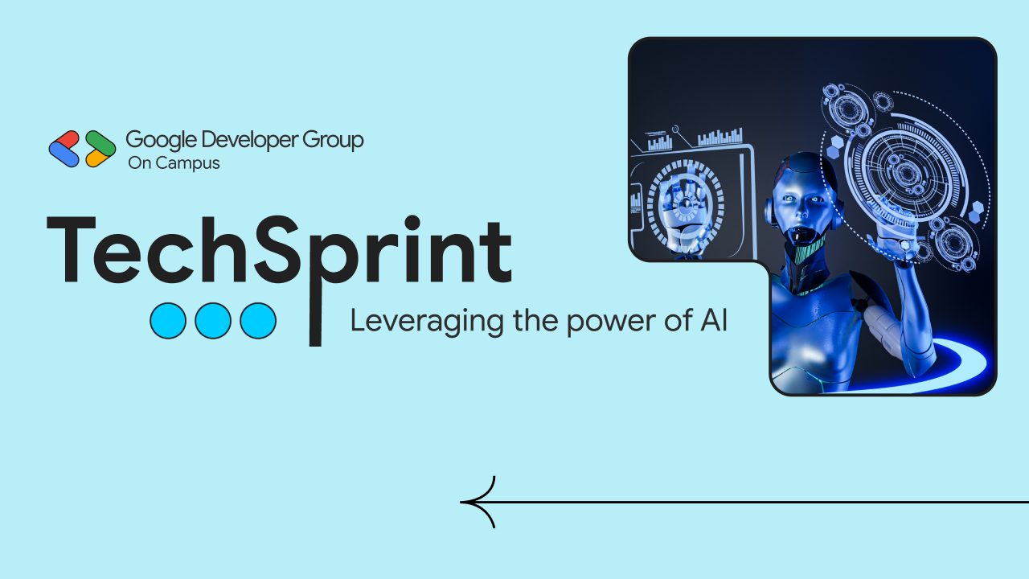
Thank you!

